Slide 1
TIC-TAC-TOE GAME
TEAM EXCEL

Slide 2
TABLE OF CONTENT
Introduction​
Primary goals
​Areas of Concentration
​Summary​

Slide 3
Introduction
At Team Excel, we are a group of motivated, enthusiast and proactive software engineers whose main focus is making a difference in the tech space.
We believe there is no limitation to what we can achieve, and at thus we decided to create a Tic-Tac-Toe game that will enable a user play with their friends.
We observe that most tic-tac-toe game out there gives a user the opportunity to only play with CPU and that makes it easy for a user to win as the CPU moves can be predicted!

Slide 4
PRIMARY GOALS
Tic-Tac-Toe “with-a-friend”

Slide 5
AREAS OF CONCENTRATION
Html
CSS
We developed the structured of the Application with HTML5
We beautify and style the Application with CSS3
JAVASCRIPT
We made the App interactive and functional with the use of Javascript

Slide 6
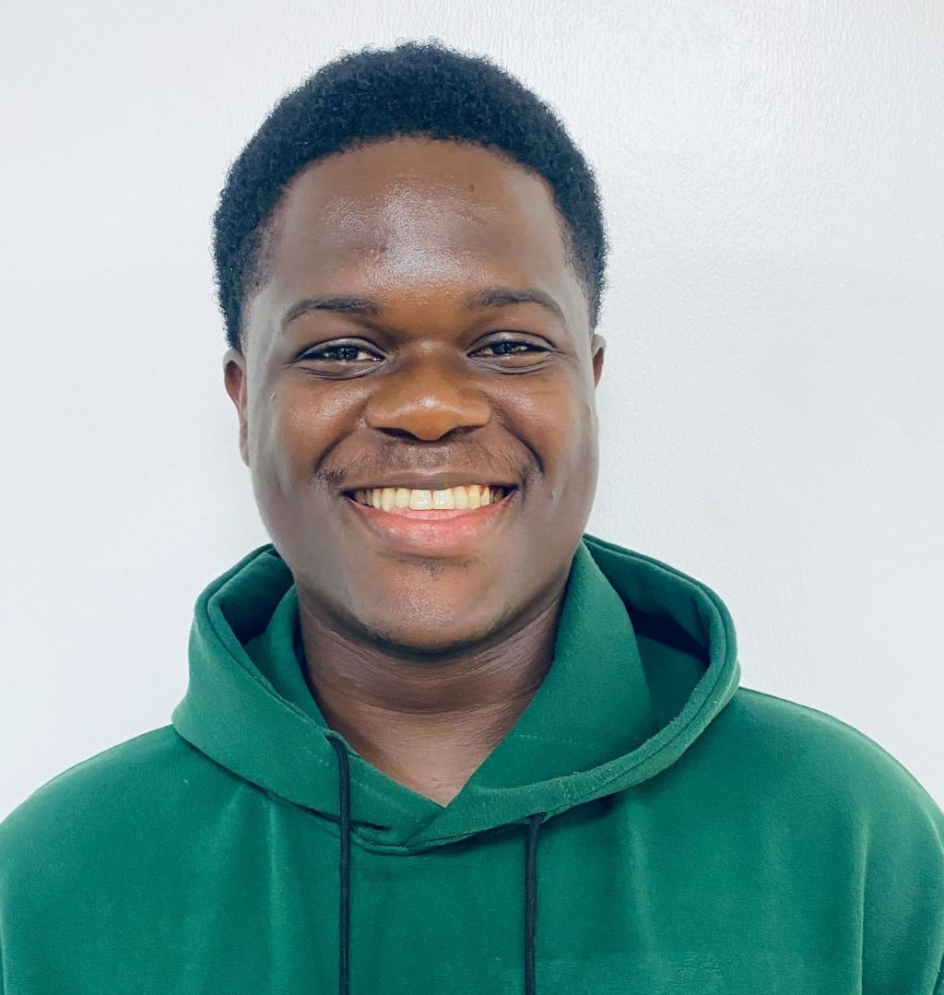

MEET OUR TEAM
Oluwatobiloba Excel
Agboola Michael o.
Oluwatobiloba Excel
Team Lead
Team Lead
Team Lead
Oluwatobiloba Excel
Oluwatobiloba Excel
Oluwatobiloba Excel
Team Lead
Team Lead
Team Lead

Slide 7



GAME PLAY
Step one
Step two
STEP THREE
Pick a Player
Select your icon
Play Game. And maybe win a bet or get a reward.

Slide 8
SUMMARY
Developing a user friendly tic-tac-toe game which allows user play with friends and family. We ensure it is responsive across all devices.

Slide 9
THANK YOU
Team Excel.

